Slide 1

Thessaloniki AirBnB Market
AirBnB Lab
Sep. 26, 2023
Princesa Cloutier

Slide 2
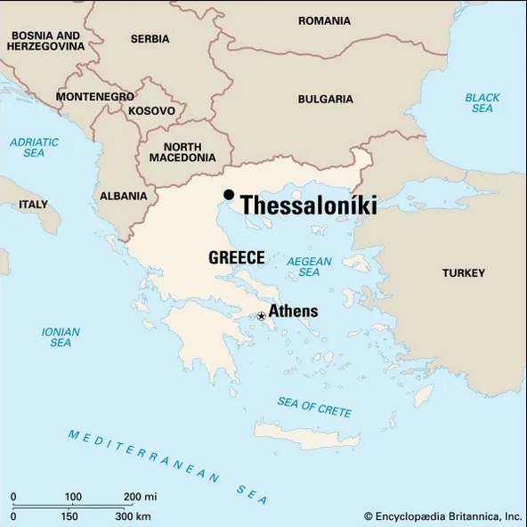
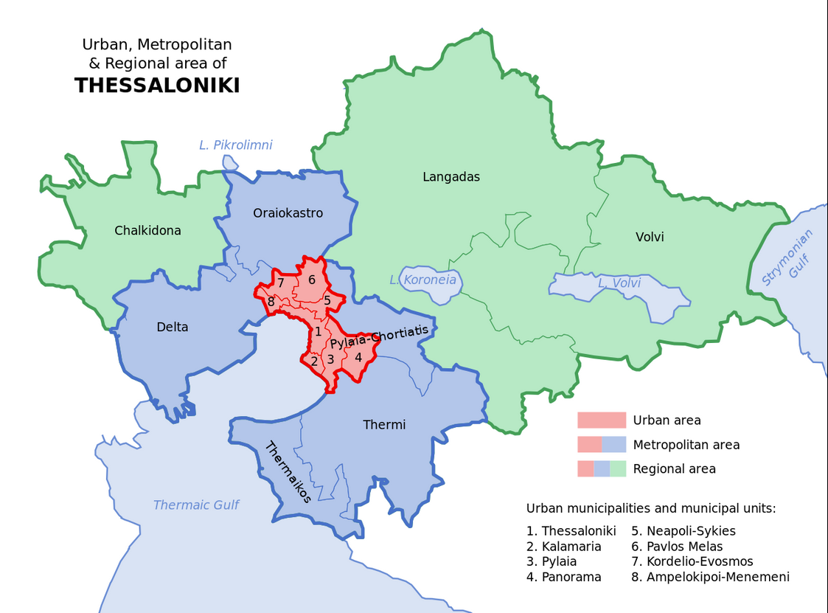
Map of Thessaloniki
Image taken from Encyclopedia Britannica, inc. - https://cdn.britannica.com/90/204690-004-6F4E708C/Thessaloniki-Greece.jpg
Image taken from Wikipedia - https://en.wikipedia.org/wiki/Thessaloniki_metropolitan_area#/media/File:Thessaloniki_urban_and_metropolitan_areas_map.svg

Slide 3
Thessaloniki by Neighborhood
22 Neighborhoods in Thessaloniki
Overwhelming number of listings posted in Thessaloniki city center
Possible data error: Data entry inconsistency and Greek – to – Roman alphabet conversion might have lost neighborhood info for some listings
Other possible error: Neighborhood definitions have changed
Kalamaria – outside of city center, but still by beaches and within the city

Slide 4
Listings by Type
Market boasts a variety of property types

Slide 5
Preferred Room Types
Overall, clients seem to prefer private accommodations
Highest average ratings were for hotel rooms and entire homes/apartments to rent.
Shared accommodations fared significantly worse

Slide 6
Revenue
Neighborhoods with highest generating properties parallel with neighborhood popularity
Again, difficult to grasp how much Thessaloniki city center is accurately reflecting data
Ignoring Thessaloniki points to Kalamaria again for total revenue.
Average revenue shows higher average revenue in Agios Pavlos
Recommendation: Kalamaria has guaranteed market based on higher number of properties, and the revenue able to be generated there is large.
As a second recommendation, however, I would also suggest looking into Agios Pavlos, as it has a higher average revenue and, with fewer listings, might be an easier location to get into the local market.

Slide 7
Thank you!

